Slide 1
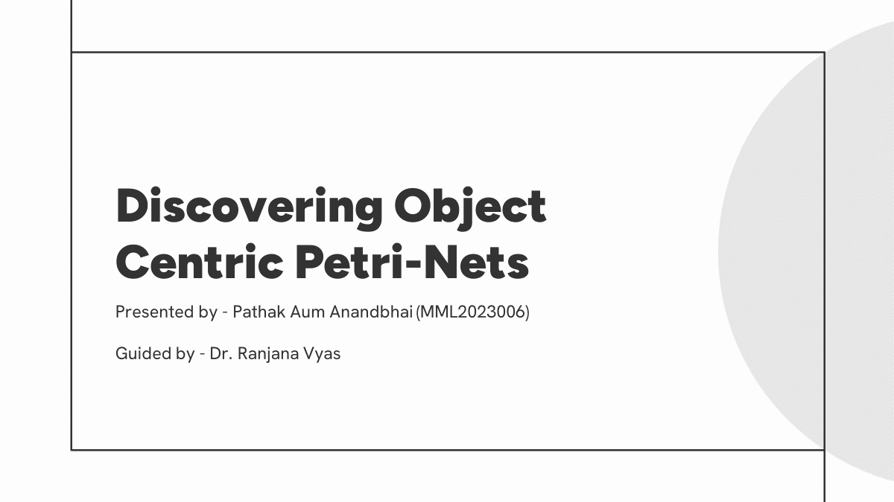
Literature Reviews

Slide 2
Overview

Slide 3
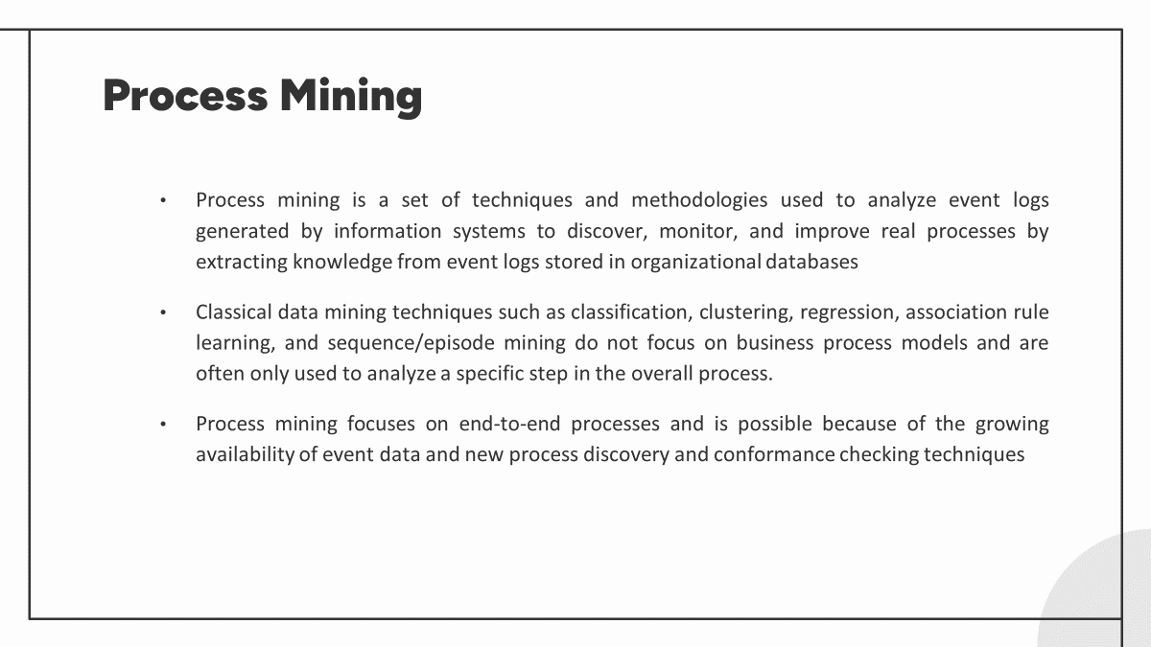
Problem Statement
Discovering Object Centric Petri Nets

Slide 4
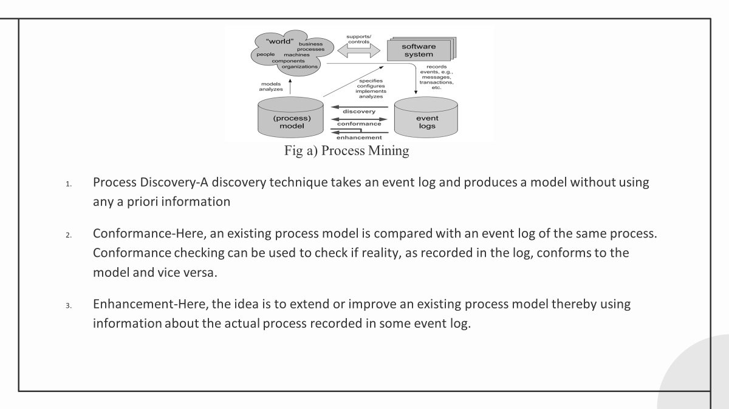
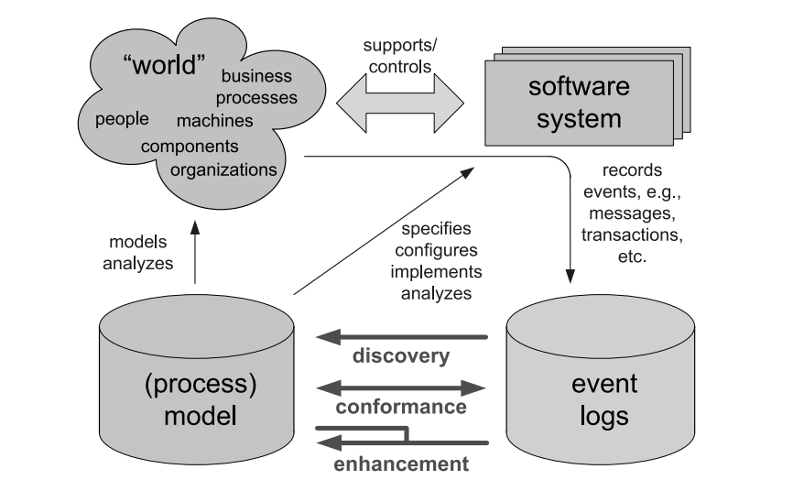
Process Discovery-A discovery technique takes an event log and produces a model without using any a priori information
Conformance-Here, an existing process model is compared with an event log of the same process. Conformance checking can be used to check if reality, as recorded in the log, conforms to the model and vice versa.
Enhancement-Here, the idea is to extend or improve an existing process model thereby using information about the actual process recorded in some event log.

Slide 5
Object Centric Process Mining

Slide 6
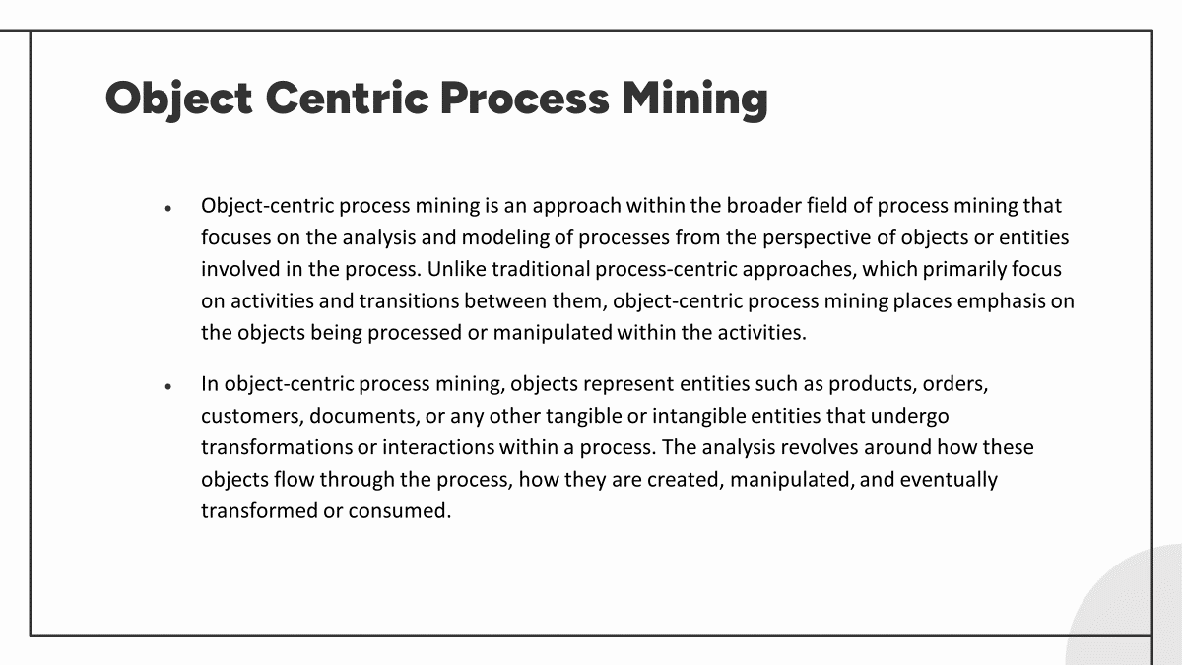

Slide 7


Slide 8
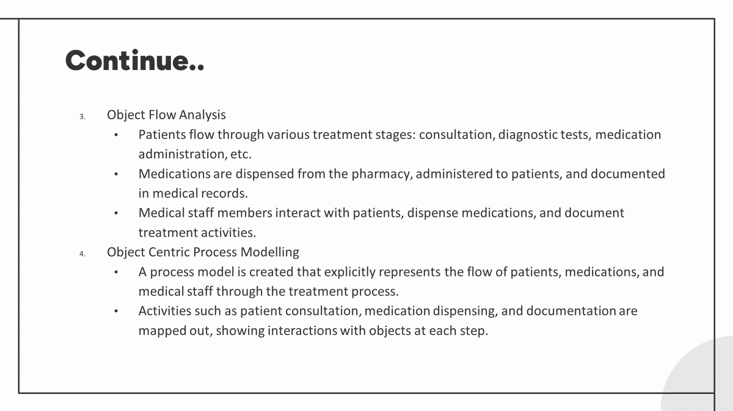

Slide 9
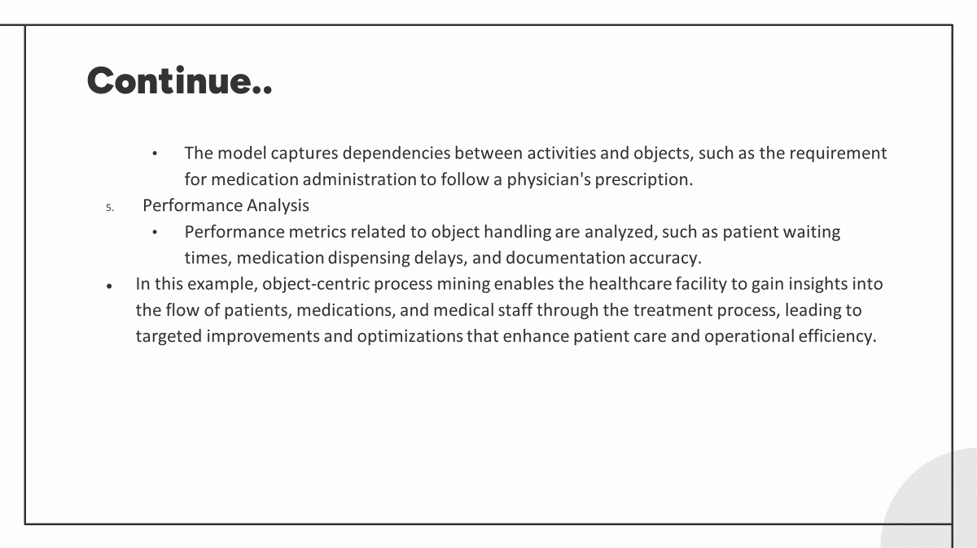

Slide 10
Problem Statement

Slide 11
Problem Statement
Discovering Object Centric Petri Nets
Petri Nets
Petri Nets are mathematical models used to represent and analyse systems characterized as being concurrent, asynchronous, nondeterministic.
They provide a formal and graphical representation of processes.
Petri Nets are widely used in areas such as workflow management, system modelling, and protocol analysis.[2]

Slide 12
Continue..
Object Centric Petri Nets
Object-centric Petri nets extend traditional Petri nets by incorporating object-oriented concepts. In these nets, objects are central entities, with transitions representing operations or actions performed on these objects.
Places hold object instances, and arcs represent relationships between objects or object states. Object-centric Petri nets are particularly useful for modeling and analyzing systems where the focus is on the manipulation and interaction of objects rather than just the flow of tokens. They find applications in areas such as software engineering, workflow management, and business process modeling.[2]

Slide 13
Literature Review

Slide 14
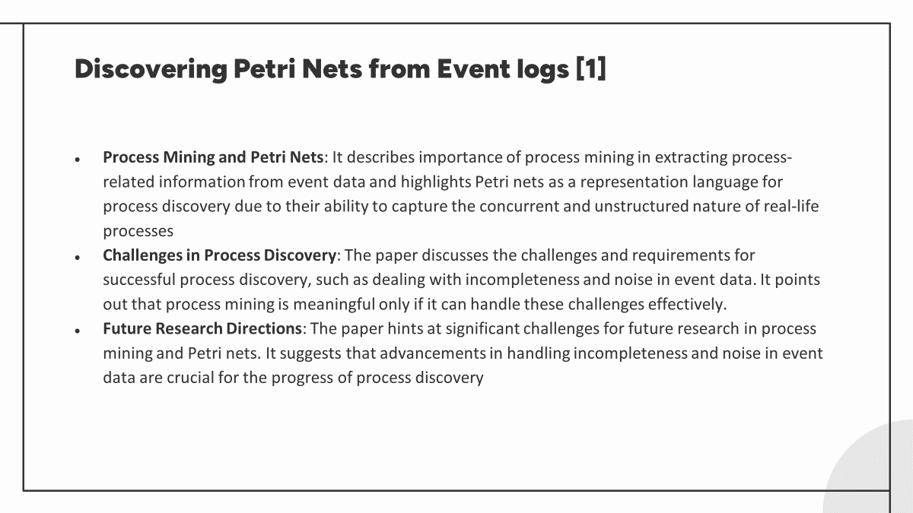

Slide 15
Process Mining: Overview and Outlook of Petri-Nets discovery algorithm[2]
Introduction to Process Discovery: The authors introduce the concept of process discovery, which involves constructing process models from event logs to understand and analyze captured behavior. They emphasize the importance of accurate process models, particularly Petri nets, in representing real-life processes effectively.
Critical Analysis and Future Direction: Through a critical analysis of existing algorithms, the authors identify areas for improvement and propose future research directions to enhance process discovery techniques and tools. This forward-looking approach aims to drive advancements in the field of process mining.

Slide 16
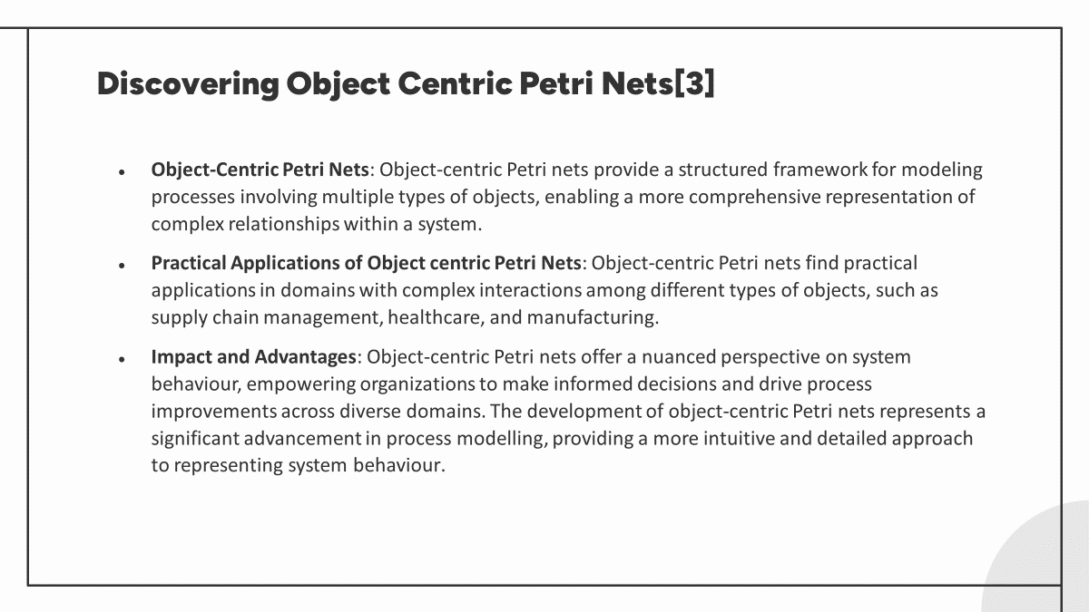

Slide 17
Proposed Methodology

Slide 18
Data Collection OCEL
Event Log Analysis
Identification of object with their relationship between events and other object
Selection of discovery algorithm with petri-nets
Evaluation of model and its refinement

Slide 19
Expected Outcome

Slide 20
Visualization of Object Interaction
Insights of Object Lifecycle
Detection of Anomalies and Deviation
Enhanced understanding of system behavior

Slide 21
References

Slide 22
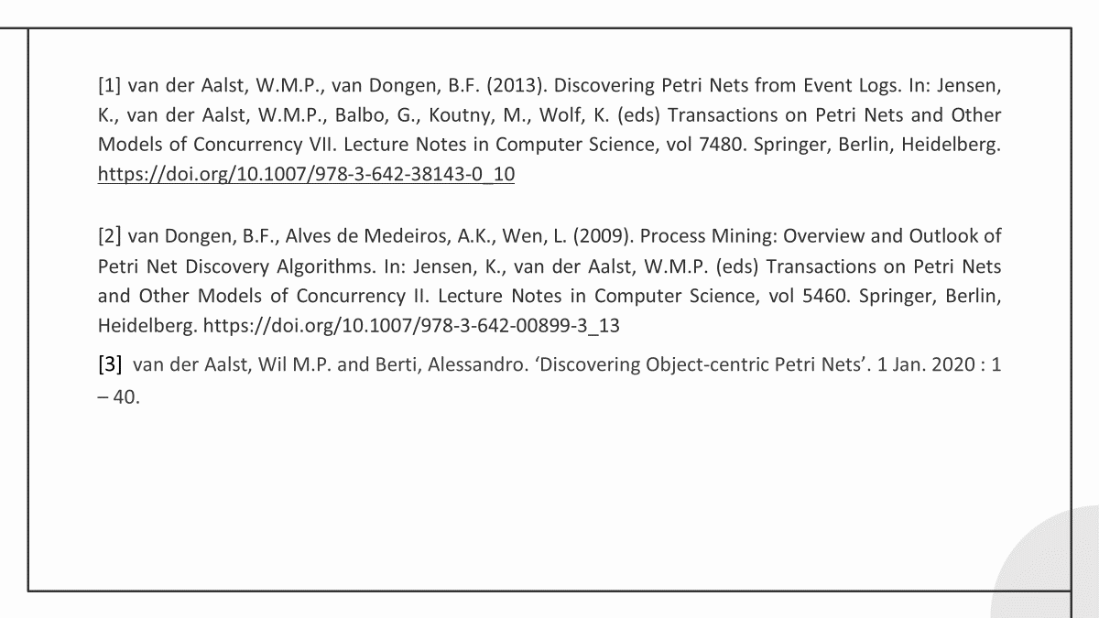

Slide 23


